Slide 1


School of Computing Science and Engineering
Course Code : E2UC403B NAME: Analysis and Design of Algorithms
Cashflow Minimiser
Presented to:
Mr. Nitin Jain
Presented by:
Nisha Varshney (21SCSE1010583)
Abhinav Kumar Choudhary(21SCSE1011615)
Divyansh Kaushik (21SCSE1011672)
Ebad Zafar (21SCSE1011484)
Program Name : B.Tech (CSE)

Slide 2
Index
Introduction
What is Cash Flow Minimizer
Key Features of Cash Flow Minimizer
Benefits of Cash Flow Minimizer
Implementation and Integration
Case Studies
Conclusion
Program Name: B.Tech (CSE)

Slide 3
Introduction
Cash flow minimizer is a strategic approach and a set of tools and techniques used to optimize cash flow management within a business.
Efficient cash flow management is crucial for the financial health and sustainability of any organization.
Businesses face several challenges in managing cash flows, which can impact their ability to meet financial obligations and make informed decisions.
Program Name: B.Tech (CSE)

Slide 4
What is Cash Flow Minimizer
Cash flow minimizer refers to the strategies and practices implemented to minimize cash flow gaps and optimize cash flow management.
Its primary purpose is to ensure that a business has enough cash on hand to meet its financial obligations while maximizing cash inflows and minimizing outflows.
By minimizing cash flow gaps, businesses can maintain financial stability, invest in growth opportunities, and reduce the risk of financial distress.
Program Name: B.Tech (CSE)

Slide 5
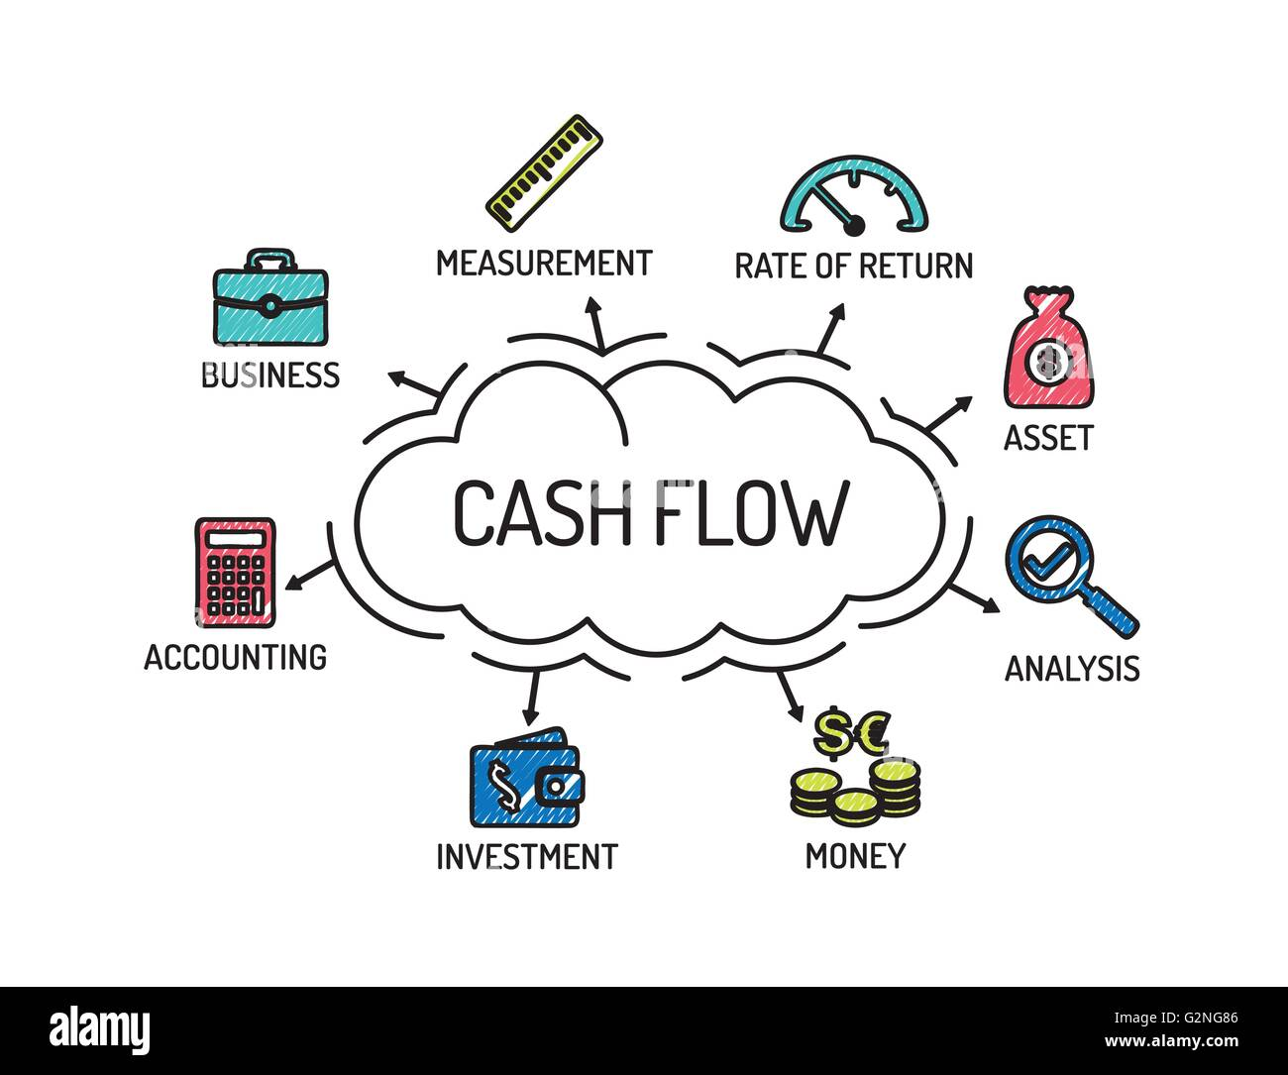
Program Name: B.Tech (CSE)

Slide 6
Key Features of Cash Flow Minimizer
Cash flow forecasting : Accurate cash flow forecasting helps in making informed decisions about investment, financing, and expense management.
Expense management : It helps businesses analyze their spending patterns, identify areas of cost reduction, and implement cost-saving measures.
Accounts receivable management : By ensuring timely payments from customers, businesses can minimize cash flow gaps and improve their working capital position.
Payables management : It helps businesses negotiate better payment terms with suppliers, optimize cash outflows, and take advantage of early payment discounts.
Program Name: B.Tech (CSE)

Slide 7
Benefits of Cash Flow Minimizer
Improved cash flow visibility : It consolidates financial data from various sources, such as bank accounts, sales records, and expenses, into a centralized dashboard.It provides real-time visibility into cash inflows and outflows.
Enhanced financial stability : Adequate cash flow reduces the risk of defaulting on loans, missing bill payments, or facing financial distress. By minimizing cash flow gaps, businesses can ensure they have sufficient funds to meet their financial obligations.
Increased profitability : By optimizing cash flow management, businesses can allocate resources more efficiently, reduce financing costs, and seize growth opportunities.
Program Name: B.Tech (CSE)

Slide 8
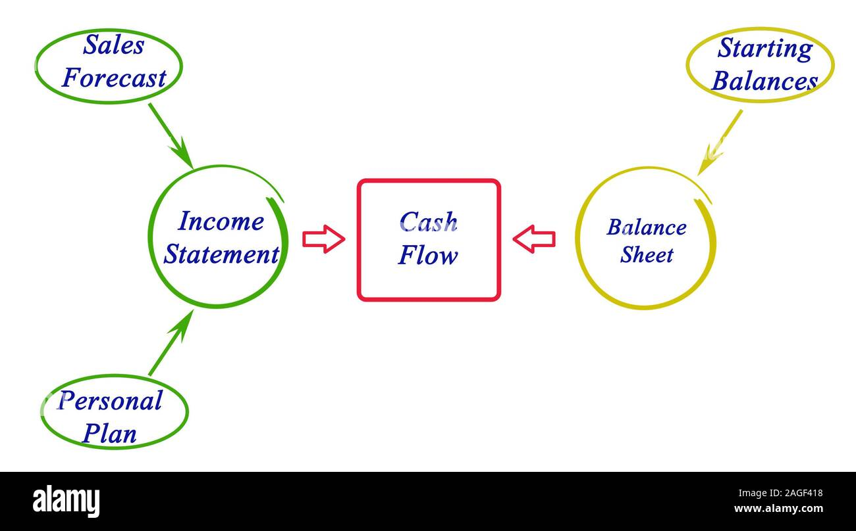
Program Name: B.Tech (CSE)

Slide 9
Implementation and Integration
Implementing and integrating a cash flow minimizer involves several key steps :
businesses need to assess their specific cash flow management needs and identify the challenges they are facing
Then, they can select a suitable cash flow minimizer solution that aligns with their requirements
Data migration is an important aspect, where relevant financial data is transferred from existing systems to the cash flow minimizer platform
Configuration and customization are necessary to tailor the solution to the business's unique needs, such as setting up cash flow forecasting parameters and expense categories
testing and user training ensure a smooth implementation process
Integration with existing systems, such as ERP or accounting software, allows for seamless data exchange and process automation
It's crucial to consider factors like data security, scalability, user adoption, and technical support throughout the implementation and integration stages
Program Name: B.Tech (CSE)

Slide 10
Case Study
Company A: Retail Business
Challenge: Company A, a retail business, faced cash flow gaps due to seasonal fluctuations and slow-paying customers. They struggled to accurately forecast cash flow and manage expenses.
Solution: Company A implemented a cash flow minimizer solution that provided robust cash flow forecasting capabilities and expense management features. They utilized historical sales data, integrated their point-of-sale system, and automated expense tracking.
Outcome: With improved cash flow visibility and accurate forecasting, Company A was able to proactively manage cash flow gaps. They implemented cost-saving measures based on expense analysis, negotiated better payment terms with suppliers, and optimized their inventory management. As a result, they reduced cash flow gaps, improved financial stability, and increased profitability.
Program Name: B.Tech (CSE)

Slide 11
Conclusion
Cash flow minimizer is a valuable tool for businesses to optimize cash flow management and minimize cash flow gaps.
Efficient cash flow management is crucial for financial stability, profitability, and overall business sustainability.
By implementing a cash flow minimizer, businesses can benefit from improved cash flow visibility, enhanced financial stability, and increased profitability.
Cash flow minimizer provides features such as cash flow forecasting, expense management, accounts receivable management, and payables management.
Program Name: B.Tech (CSE)

Slide 12


